Slide 1
Bail Conditions templates
You are welcome to use these templates to help someone understand the conditions/rules that they are expected to stick to.
Get in touch with us if you want to discuss supporting communication.
The Talking Trouble team
There are more resources on our website – www.talkingtroublenz.org and you contact us at Contact@talkingtroublenz.org

Slide 2
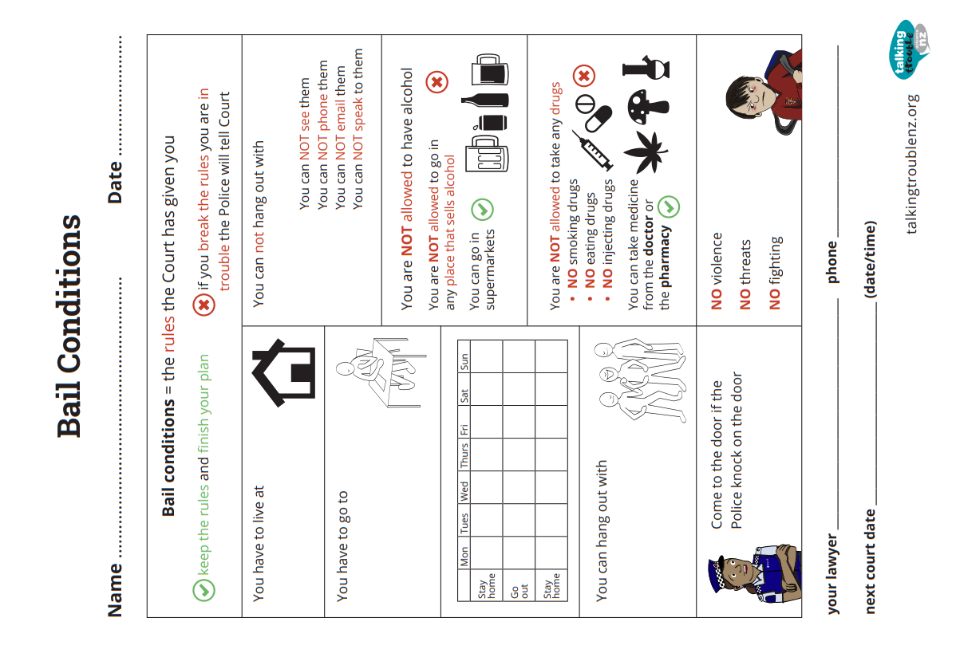

Slide 3
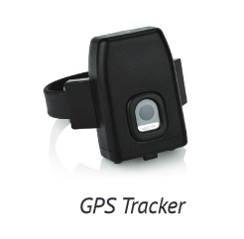
Peter Piper – EM BAIL CONDITIONS [5 May 2022] These are the RULES you have to stick to, Peter.
You have to live at:
ADDRESS (Dad’s)
You have to wear the EM bail bracelet.
You cannot leave the house
unless EM bail say you can leave the house
Call Paul to plan for any times you might need to leave.
BEFORE you can go anywhere, make sure EM Bail have said YES, you can go. If EM Bail say no, you cannot go anywhere.
Court
Paul or Sue will tell you when you have to go to Court.

Slide 4
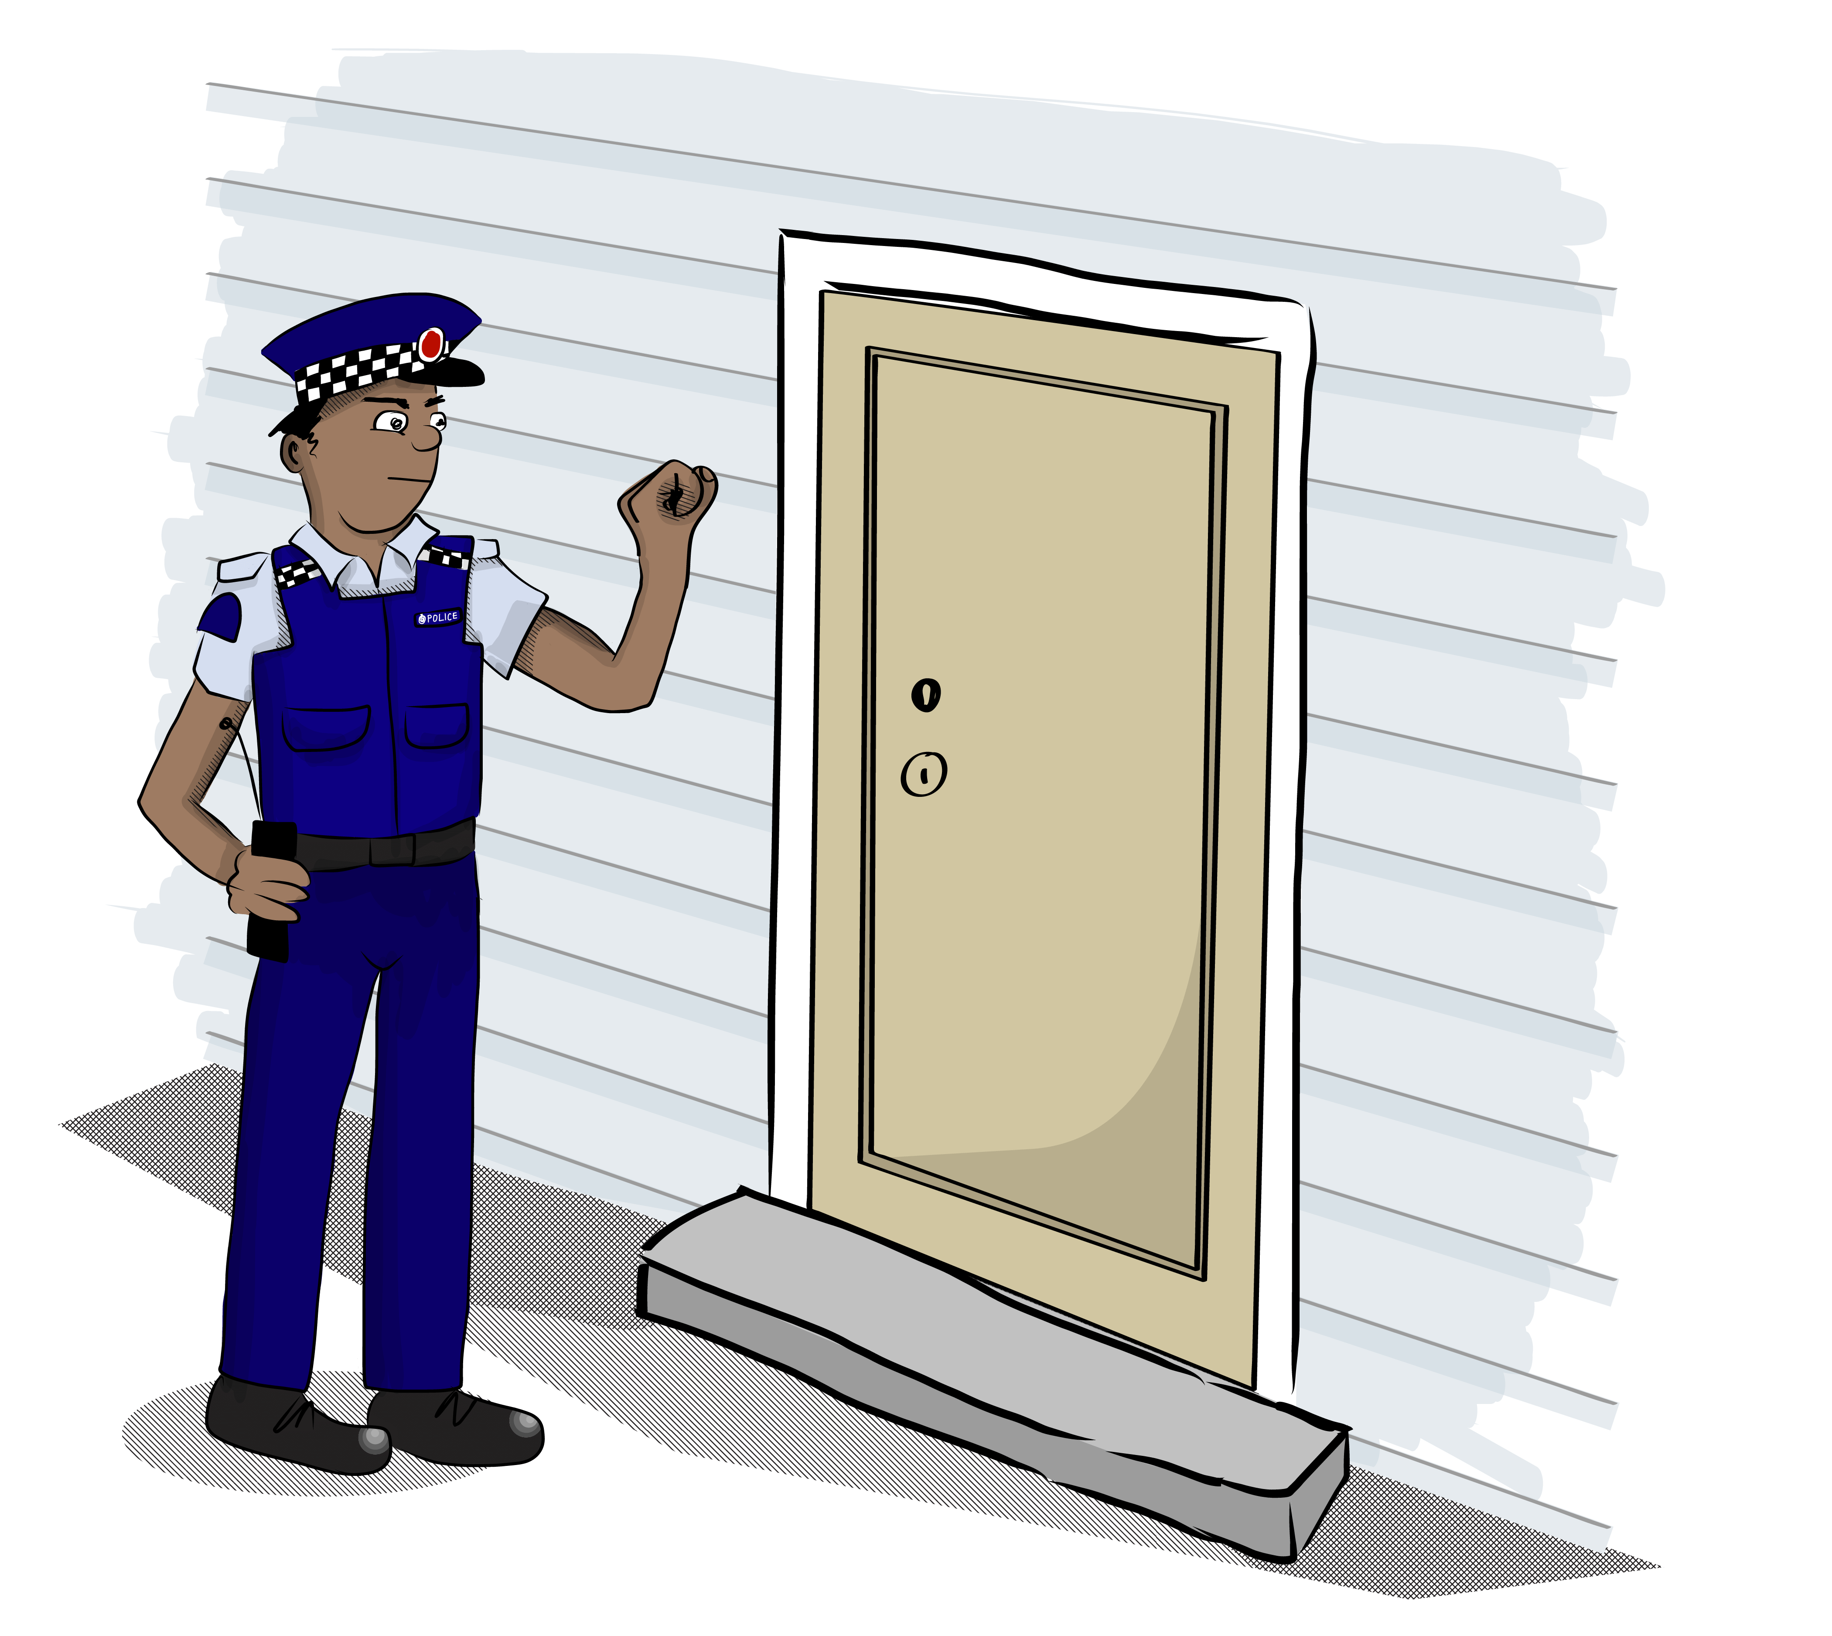
Peter Piper – EM BAIL CONDITIONS [5 May 2022] These are the RULES you have to stick to, Peter.
EM BAIL:
Stay at home
Keep your EM bracelet on
You need to come to the door for Police or EM bail staff.
EM Bail staff might need to come in
to sort out the bracelet and equipment.
You have to let them in the house to do their work.
Looking after your EM bracelet:
✓ Charge every day for 2 hours.
Unplug the cordless charger and put on bottom of the EM bracelet
DO NOT
Get the cordless charger wet
Unplug or cover the monitoring unit
Break or damage the bracelet or monitoring unit
v
Stay at home
Don’t leave

Slide 5
Peter, you have to: do the plan and see the people you’re asked to see
Do what Oranga Tamariki asks you to do
Do what Supported Bail asks you to do
Do what people from TYMES or Ministry of Education ask you to do
Go to any appointments you’re asked to go to

Slide 6
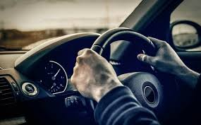
Peter, you are NOT allowed to drive
You can NOT drive any kind of vehicle.
No cars
No motorbikes
No vans
No trucks
Nothing
Peter, you are NOT allowed to have anything to do with the victims (the people who got harmed or hurt)

Slide 7
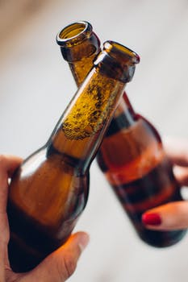
Peter, you are NOT allowed to have alcohol

Slide 8
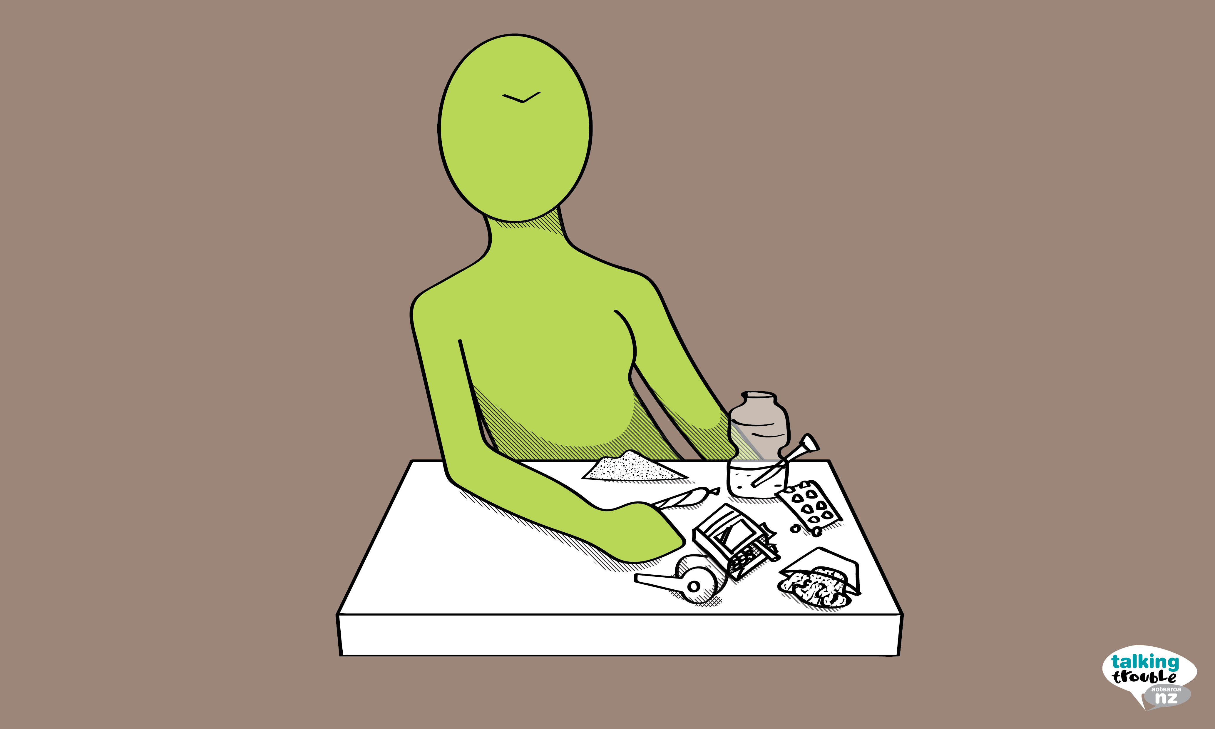
Peter, you are NOT allowed to take any drugs NO smoking drugs NO eating drugs NO injecting drugs You can take medicine from the doctor or the pharmacy 

Slide 9
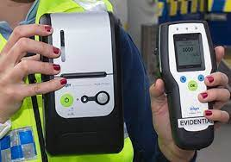
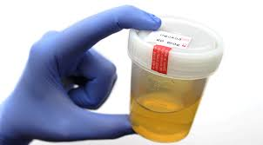
Peter, if the Police ask you to do a drug or alcohol test, you have to do the test

Slide 10
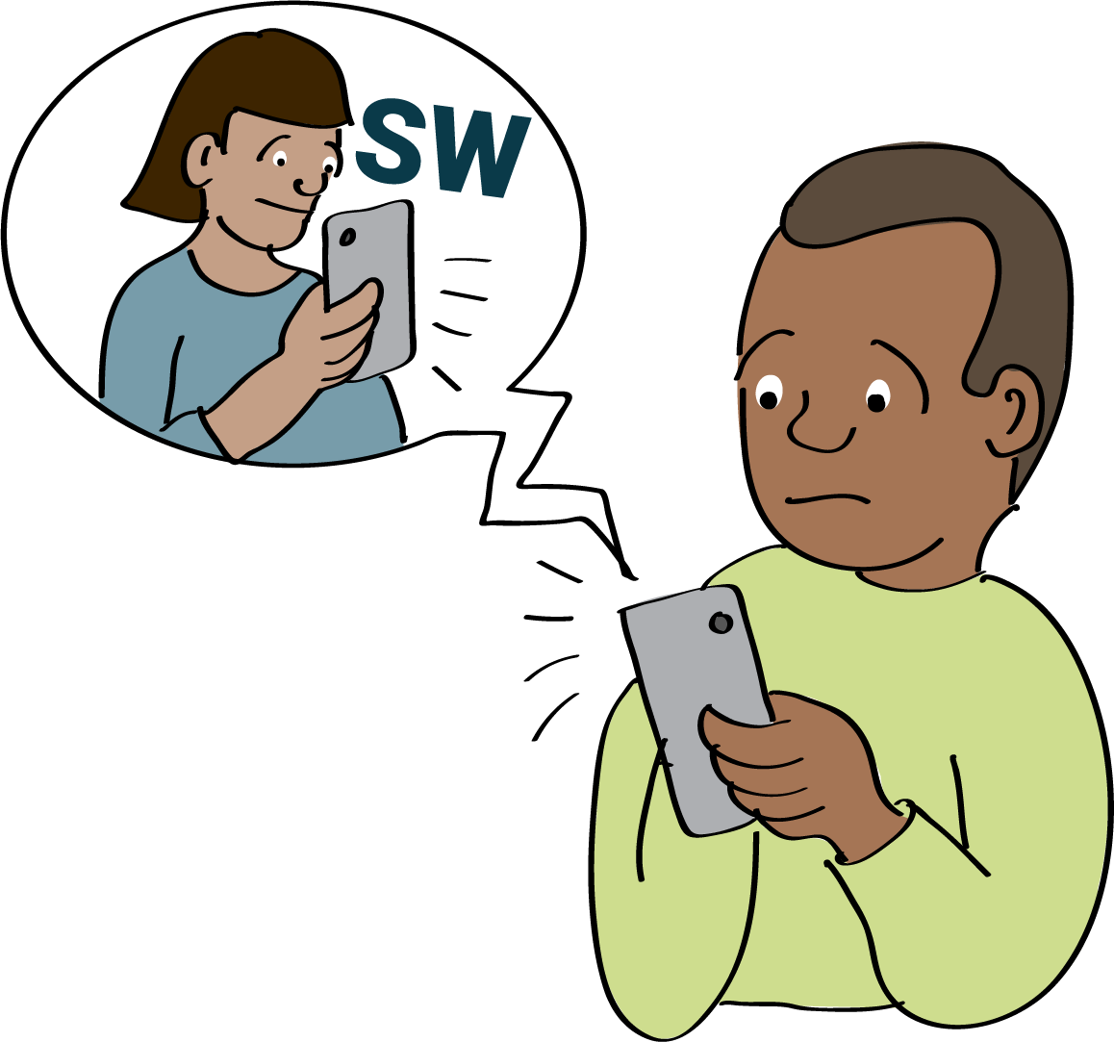
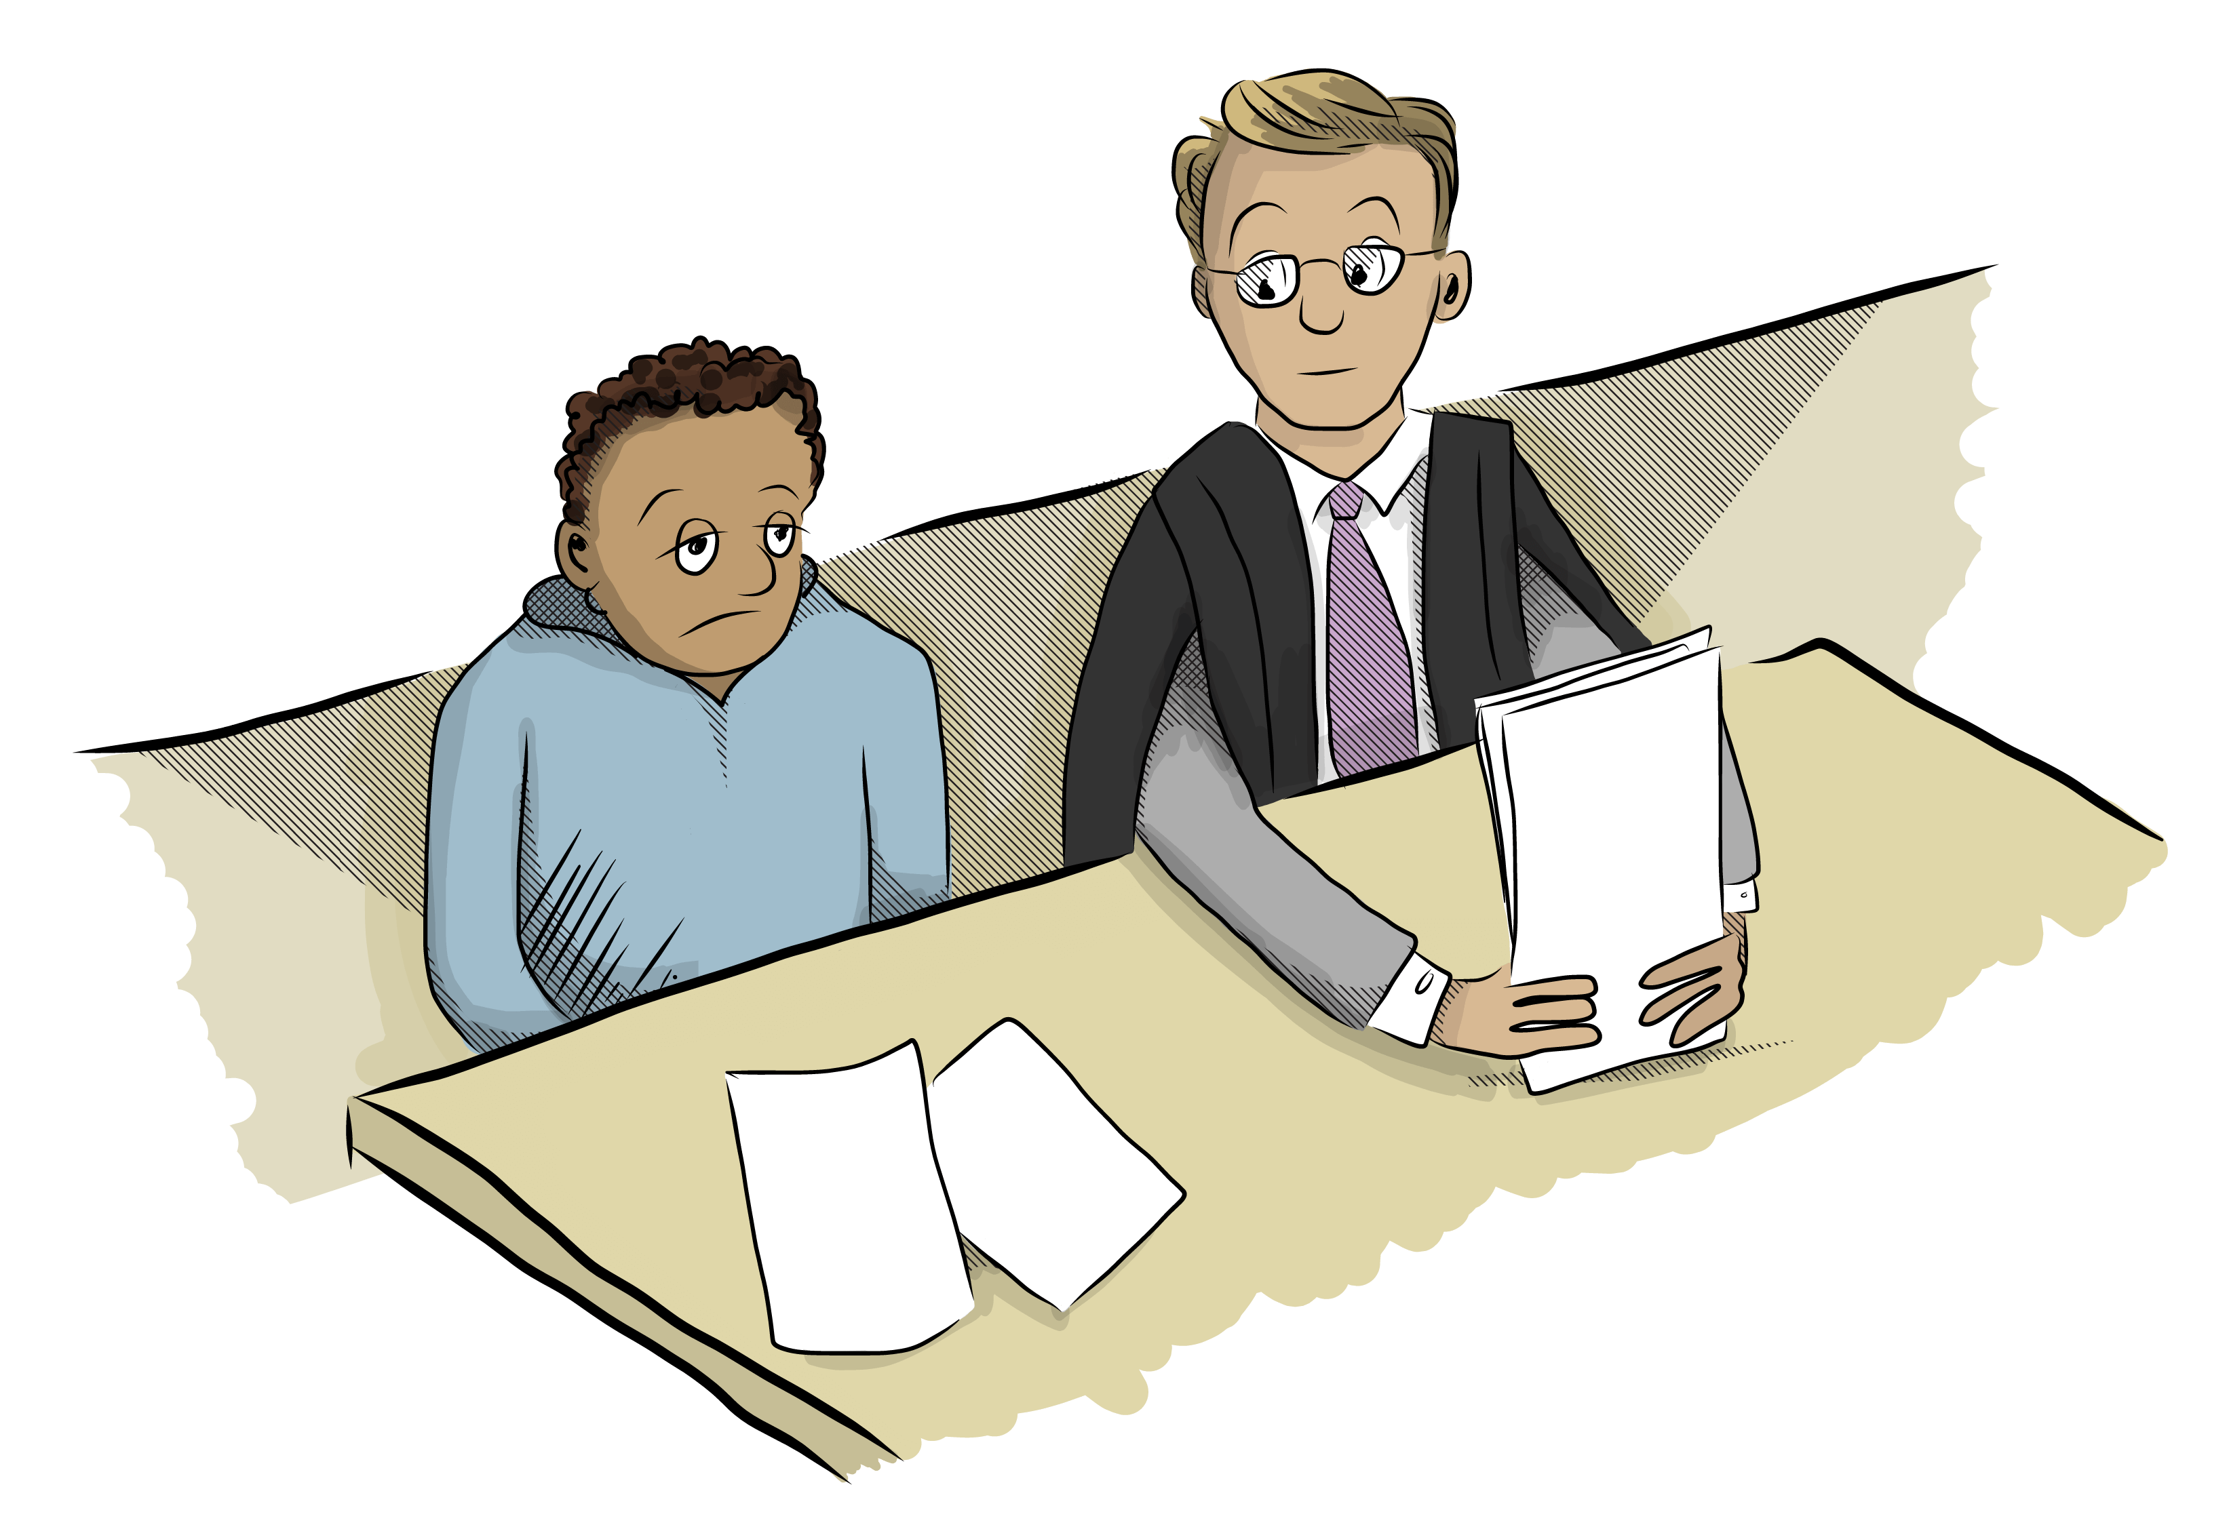
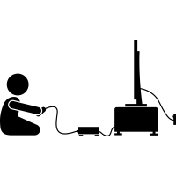
Peter Piper – What to do if you need help
WHAT CAN I DO at HOME
Who will be helping me:
These people can help. If you have a problem or are worried you can call them.
Social Worker(s):
NAME
NUMBER
Lawyer:
NAME
NUMBER
EM Bail
Team
0800 362 245
You MUST call EM Bail if
you need to go somewhere like Court or the doctor
If there is a problem with your bracelet EM bail can help
workout do some art listen to music
rest play cards help clean the house
talk to family read watch TV or a movie
gaming play music help with cooking

